Slide 1
Result Training Classes

Slide 2
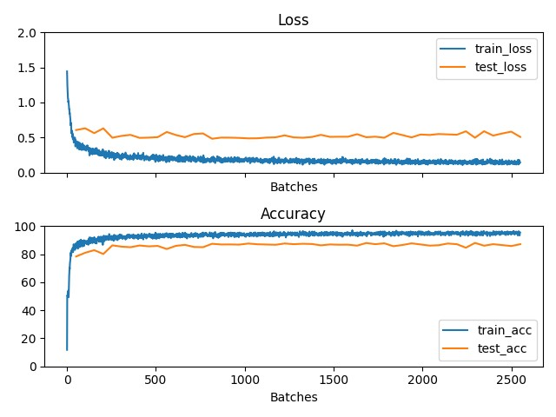
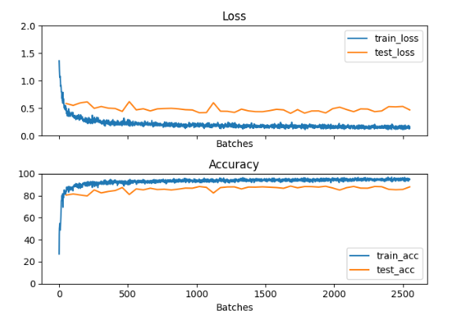
Result of Training and Testing Data 4 Classes
My result:
Paper:

Slide 3
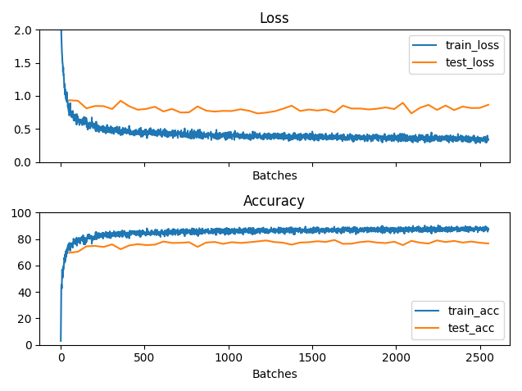
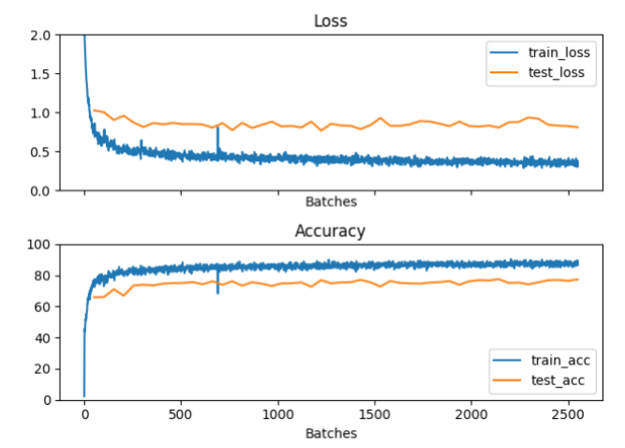
Result of Training and Testing Data 9 Classes
My result:
Paper:

Slide 4
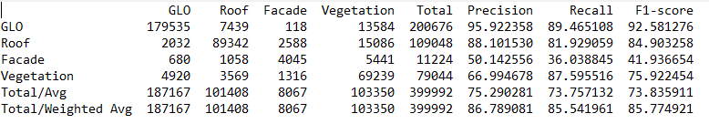
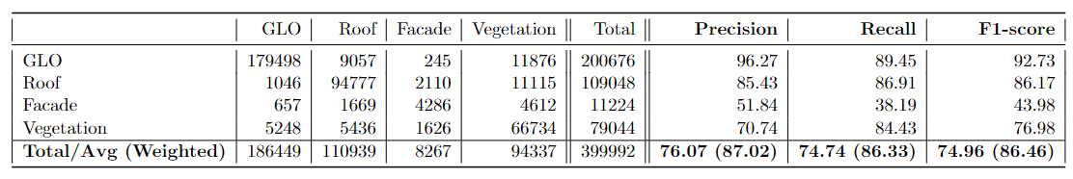
Result of Training and Testing Data 4 Classes
My result:
Paper:

Slide 5
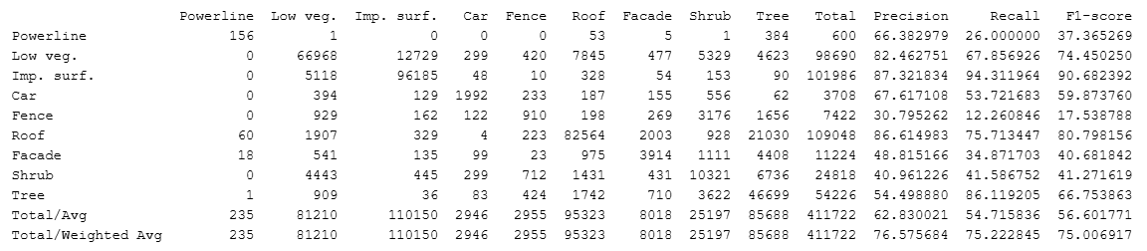
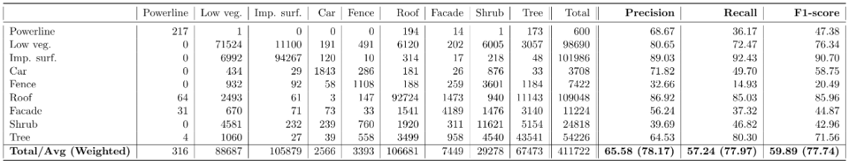
My result:
Paper:

Slide 6
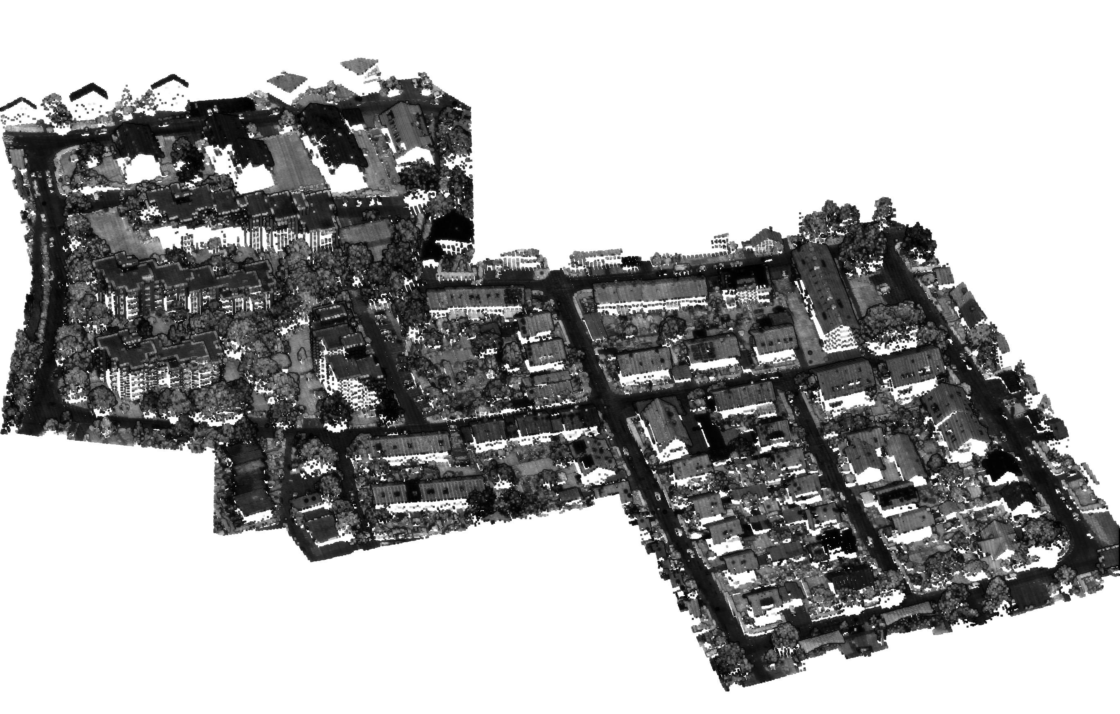

Result from Data 9 Classes
My result:
Paper:

Slide 7
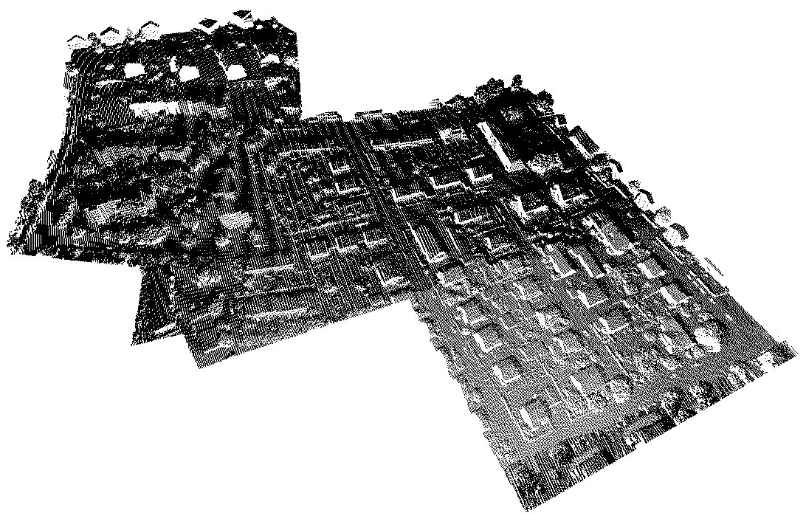

Result from Data 4 Classes
My result:
Paper:

Slide 8
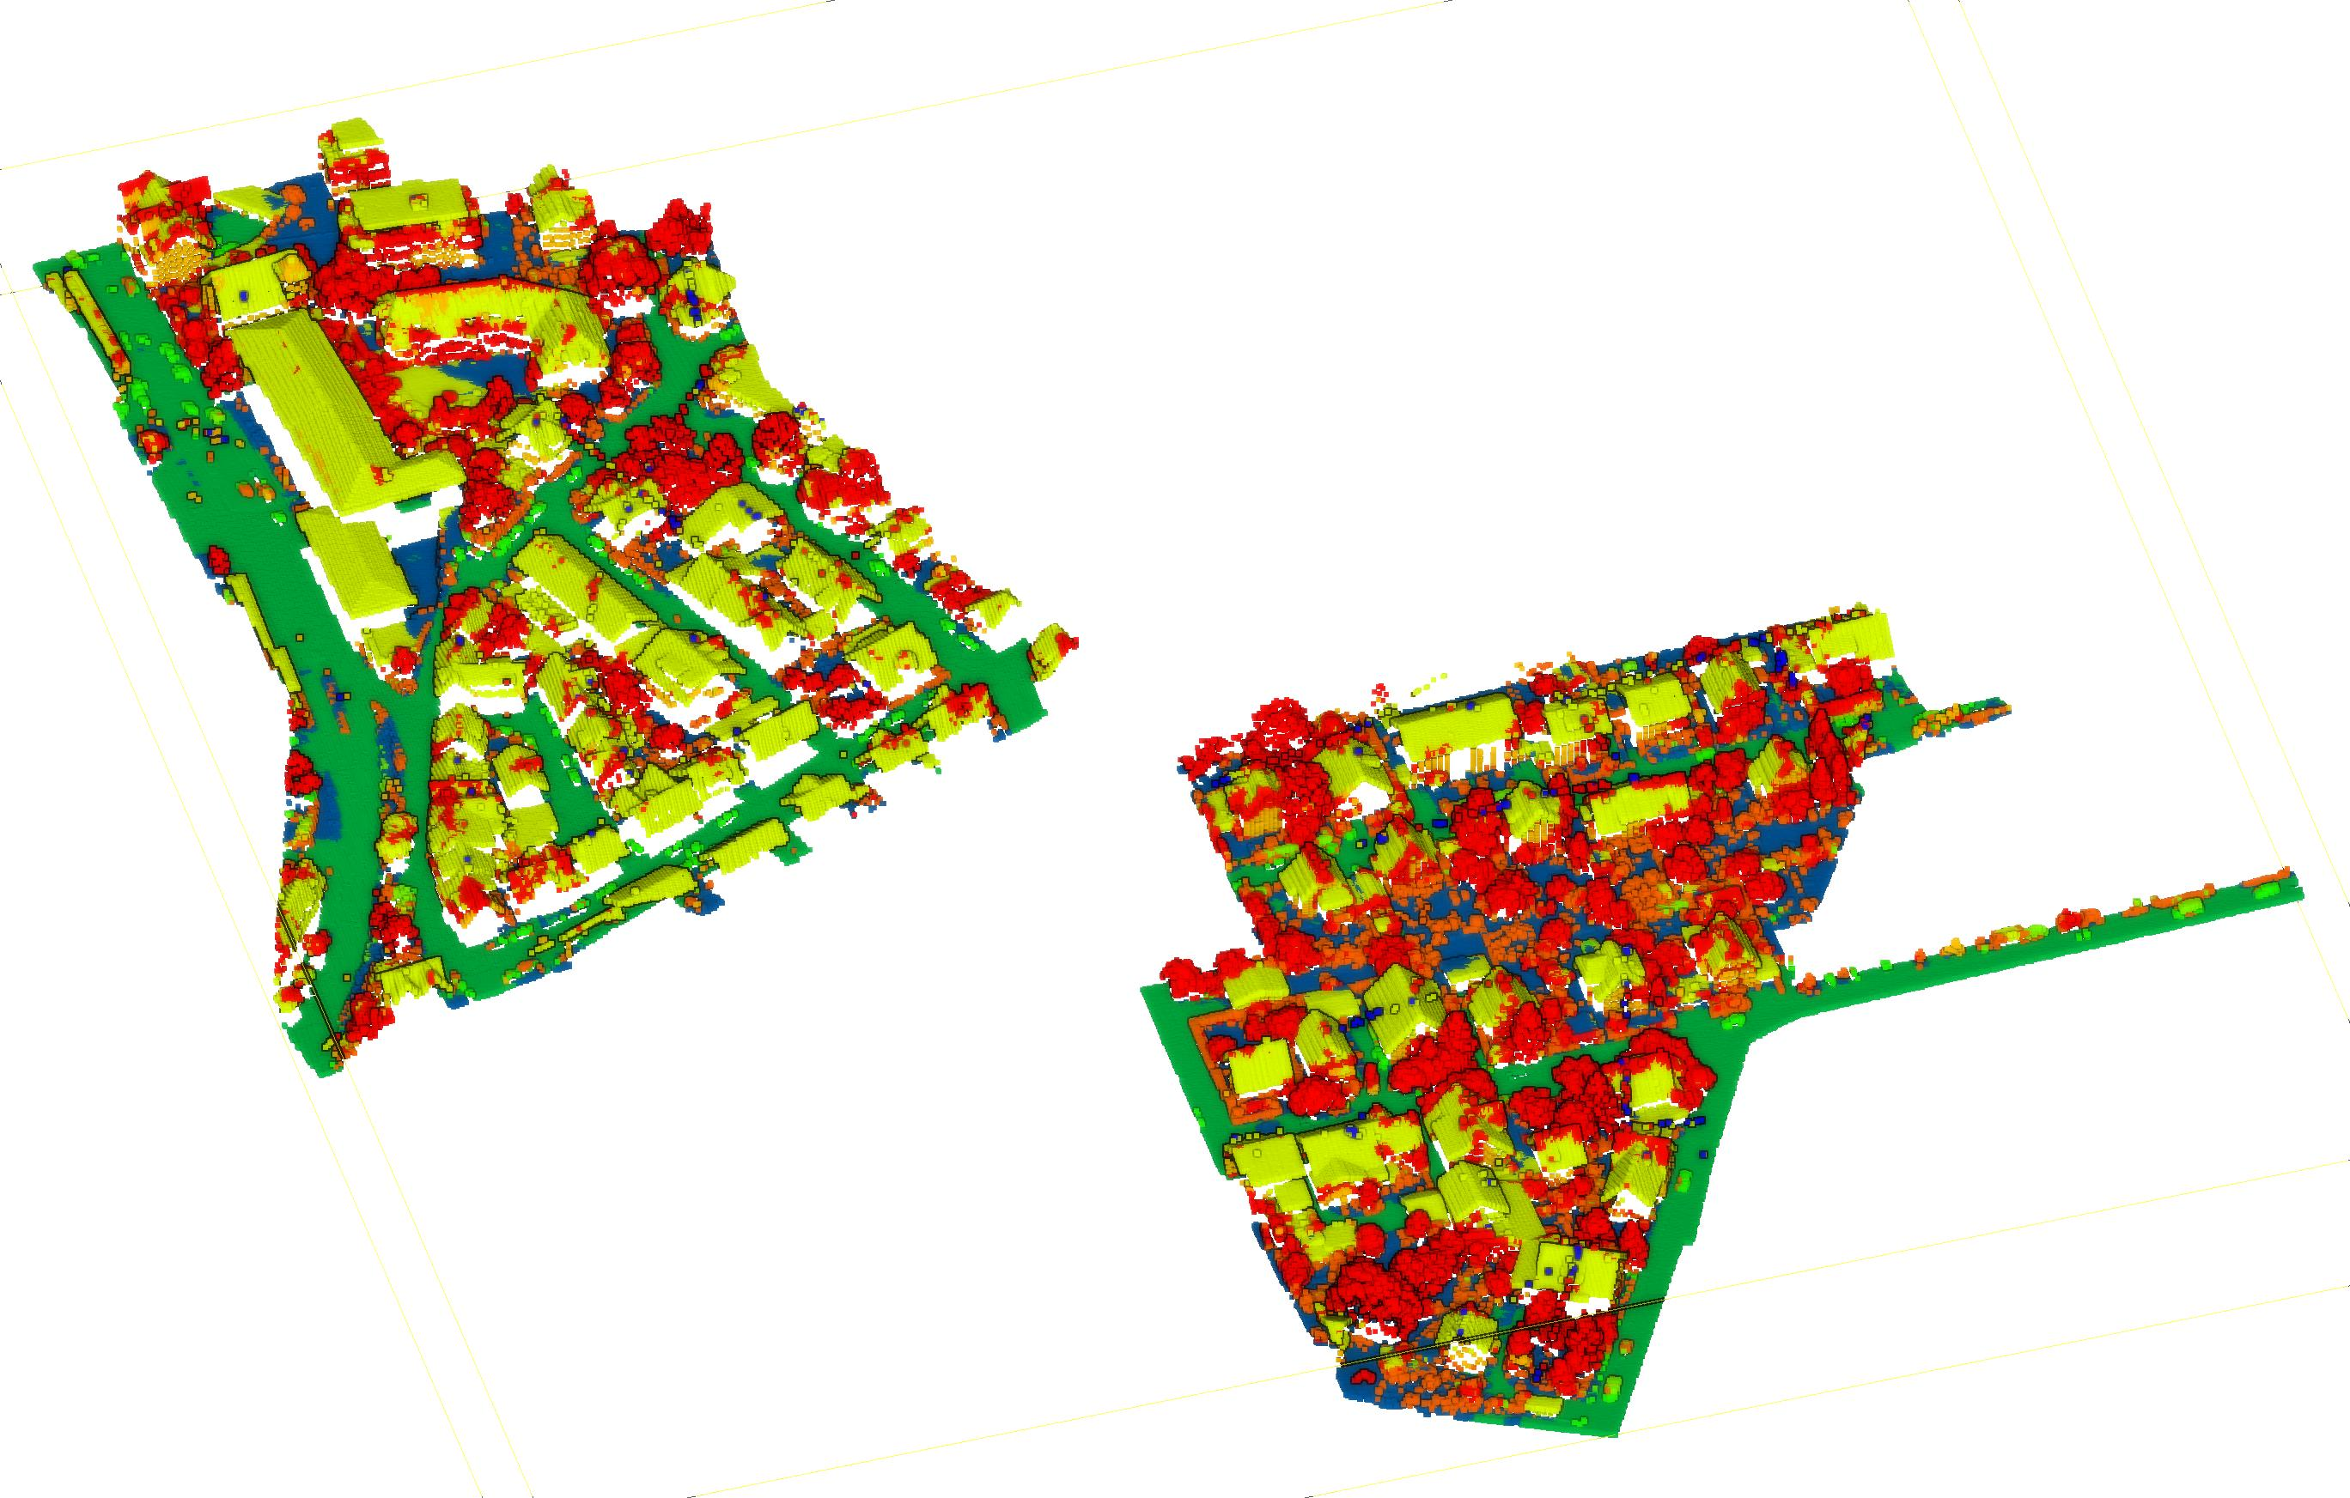
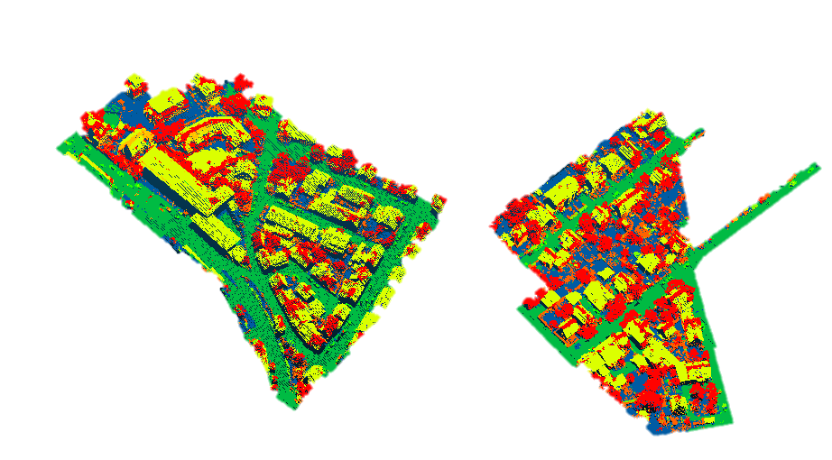
Result from Data 9 Classes
My result:
Paper:

